Slide 1
2019120059 Park Jintae
DATA403(00) Student Presentation
(Reinforcement Learning)

Slide 2
Contents
1. Selected Algorithm
- TD3
2. Selected environments
- Mujoco Walker2D-V4
- Mujoco Hopper-V4
- Mujoco HalfCheetah-V4
3. Results

Slide 3
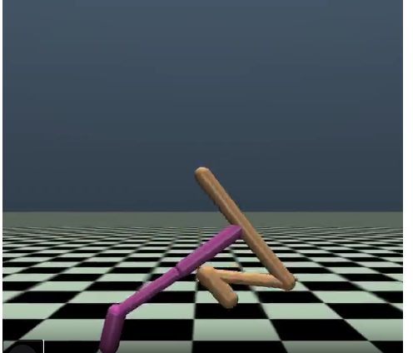
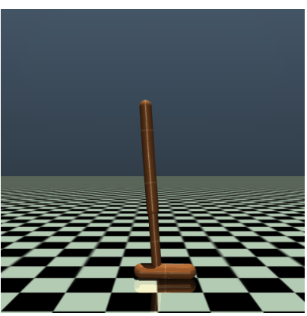
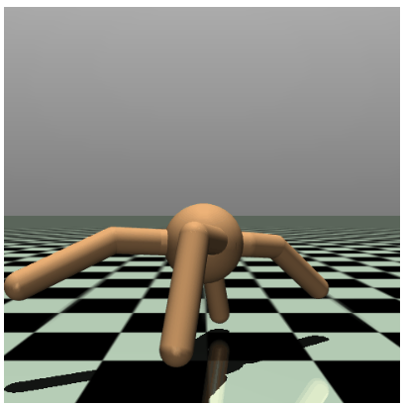
1. Background of selecting TD3
The idea of DDPG was really impressive!
“ Taking deterministic action in continuous environment”
Looked similar with our daily life actions.
So, Tried to solve Mujoco Environments with DDPG Algorithm

Slide 4
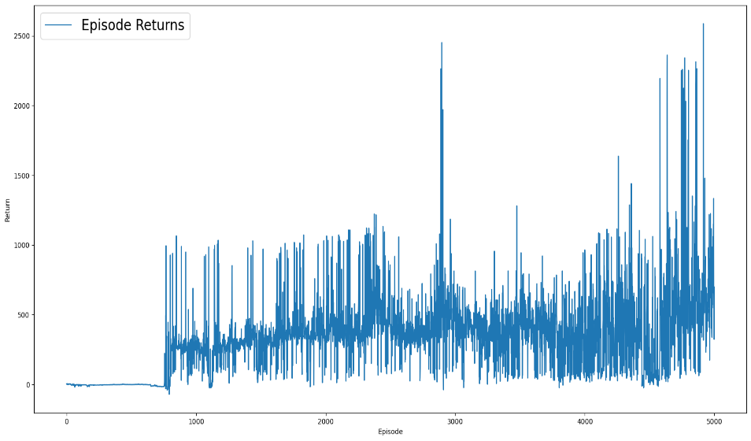
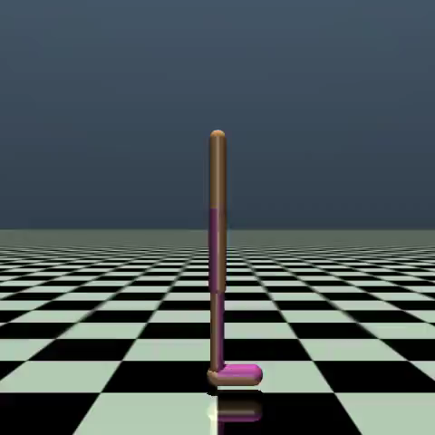
1. Background of selecting TD3
At first, Tried to solve
[Walker2D, Ant, Hopper] with “DDPG” Algorithm
Lots of Trial & Error
(Hyperparameter Tuning, PER, Deeper Network …)
But Poor & Unstable performance

Slide 5
1. TD3
After lots of trial & error found that
TD3 Algorithm has much more
“stable” and “Good” Performance.
Twin Delayed Deep Deterministic Gradient
Twin Learning
Double Q-Learning addresses the maximization bias
Delayed Learning
Actor less frequently updated than Critic
Much more Stable Learning

Slide 6
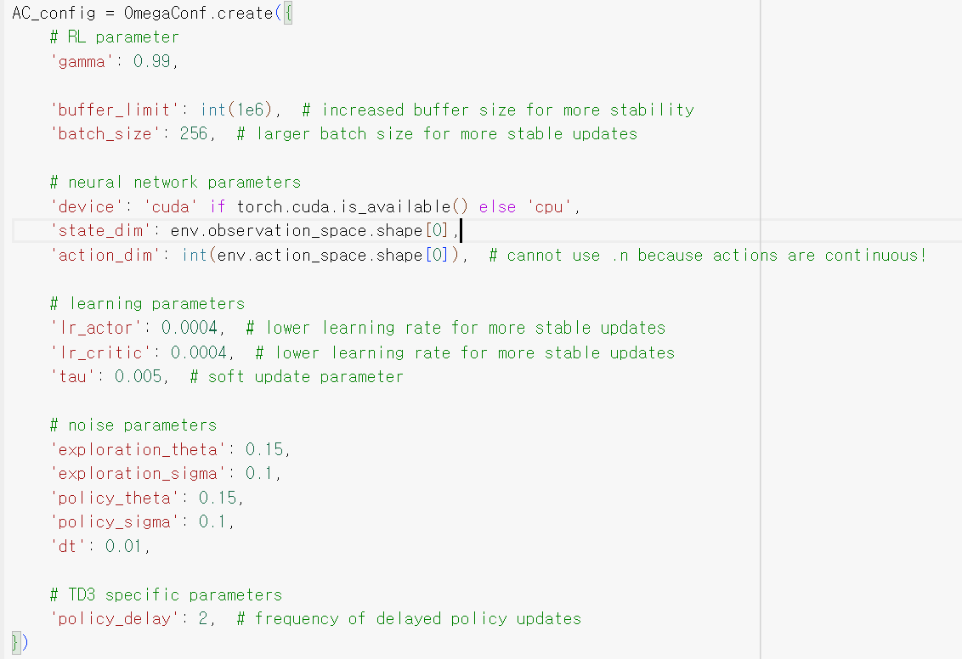
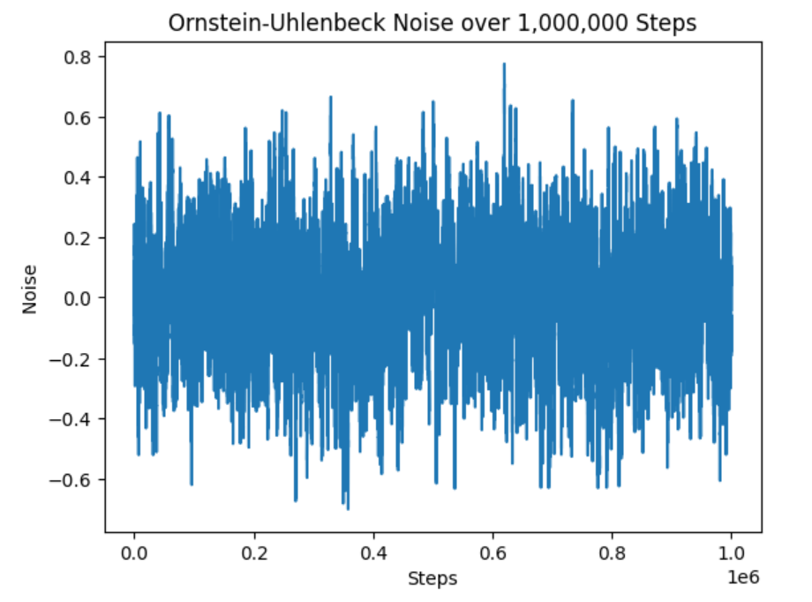
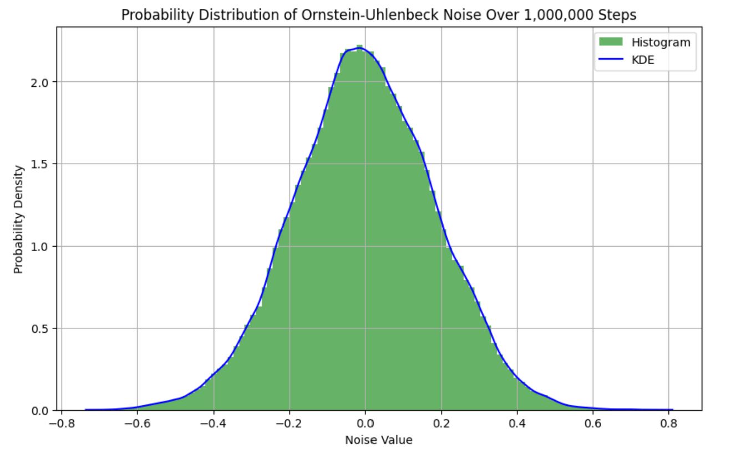
1. TD3
Compared to In-Class-Lab Code’s Hyperparameter
- Increased Buffer Size to 1e6
- Increased Batch size to 256
Consider sufficient experiences
- Learning rate 0.0004
(It was most stable)
- Increased Sigma (Noise Parameter) to 0.1
(More Exploration) and
aligned theta and dt with Sigma (Sufficient Exploration)
- Policy update delay to 2 (Delayed Learning of Actor)

Slide 7
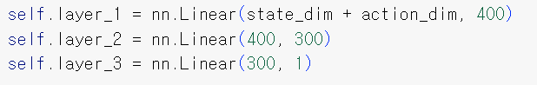
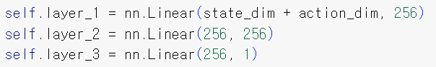
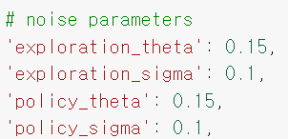
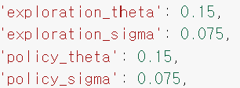
2. Selected Environments
Environments (Lv.2)
Walker2d
Hopper
HalfCheetah
Solved Environments with same TD3 Algorithm.
Only Difference
Hidden Layer Size (Walker2D, HalfCheetah more complex than Hopper)
→ Bigger hidden layer size in Walker2D, HalfCheetah
- Noise Size (More dynamic movement in Walker2D)
→ Larger Noise in Walker2D
Walker
Hopper

Slide 8
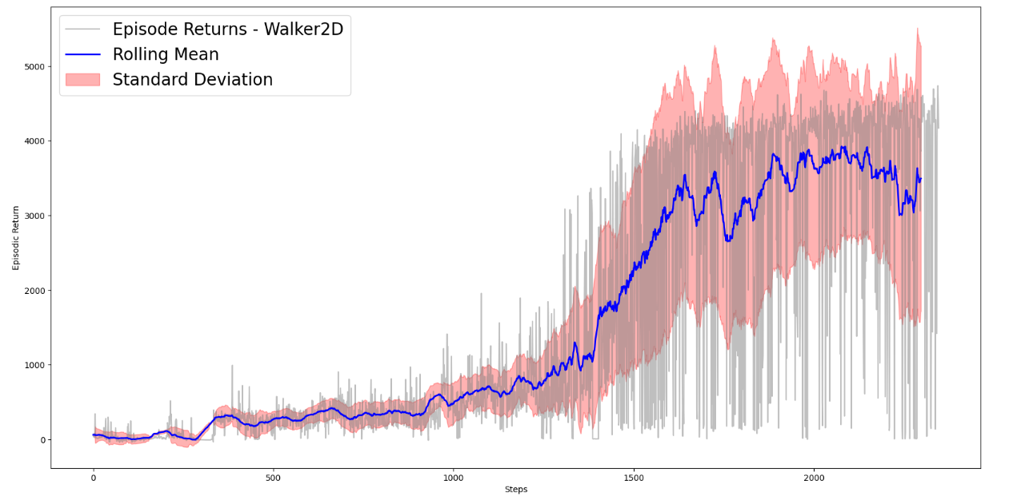
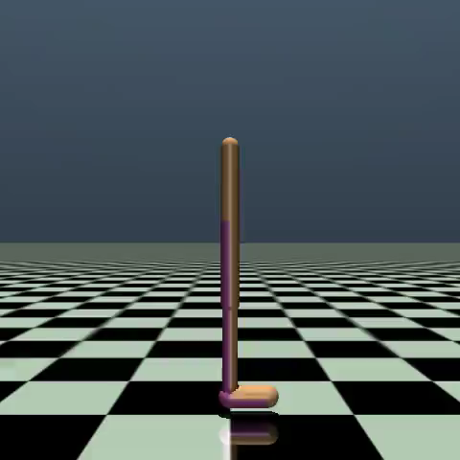
3. Walker2D Result

Slide 9
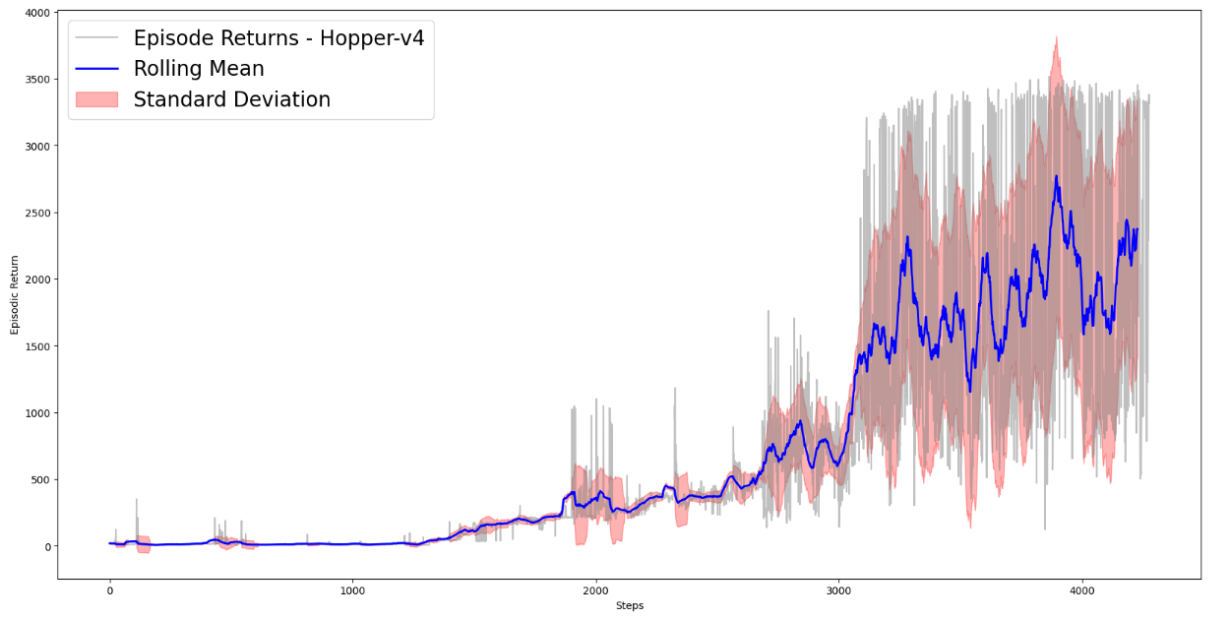
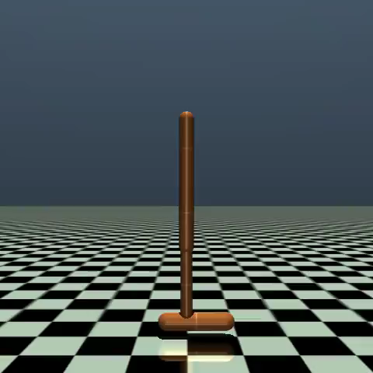
3. Hopper Result

Slide 10
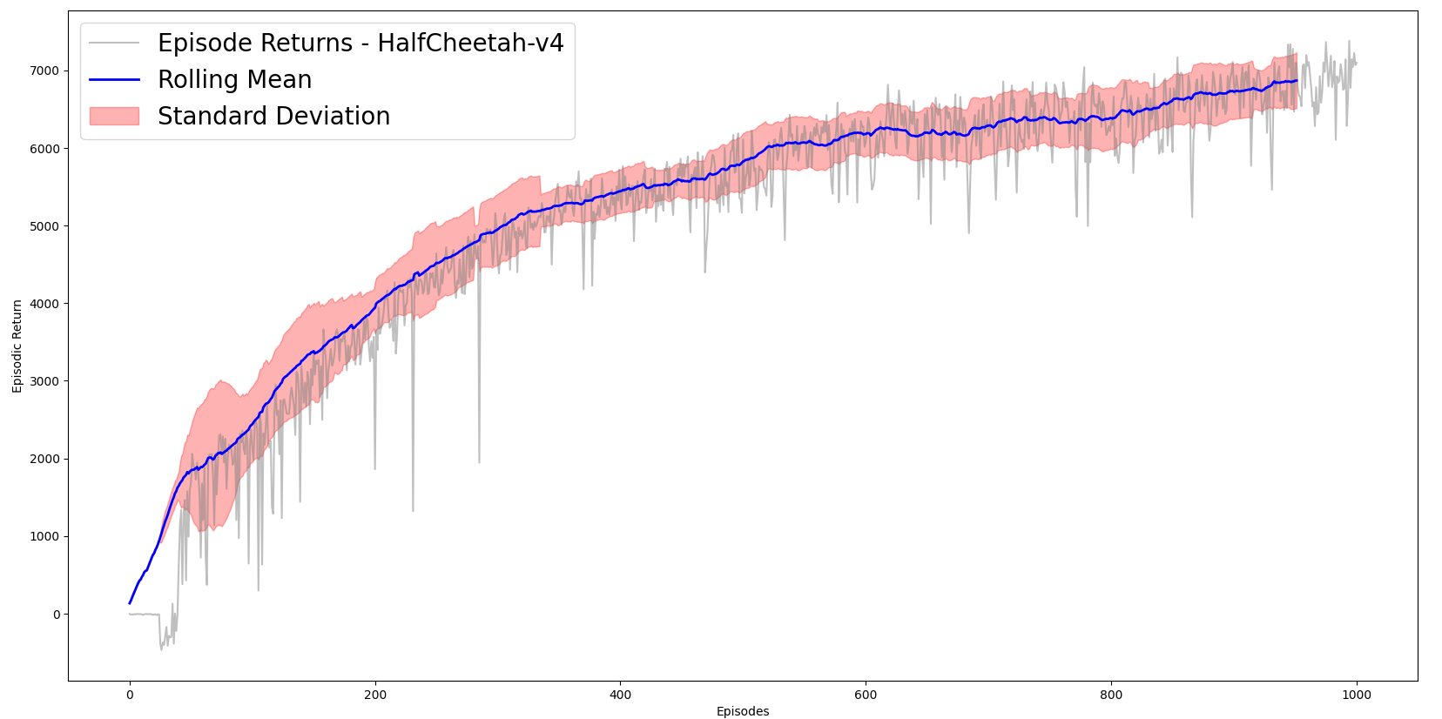
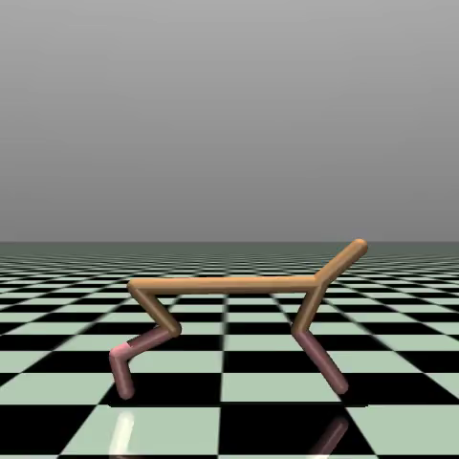
3. HalfCheetah Result

Slide 11
Thanks!
Q & A

